Slide 1
Welcome to INFO 511
Lecture 0 Dr. Greg Chism

Slide 2
Hello world!

Slide 3
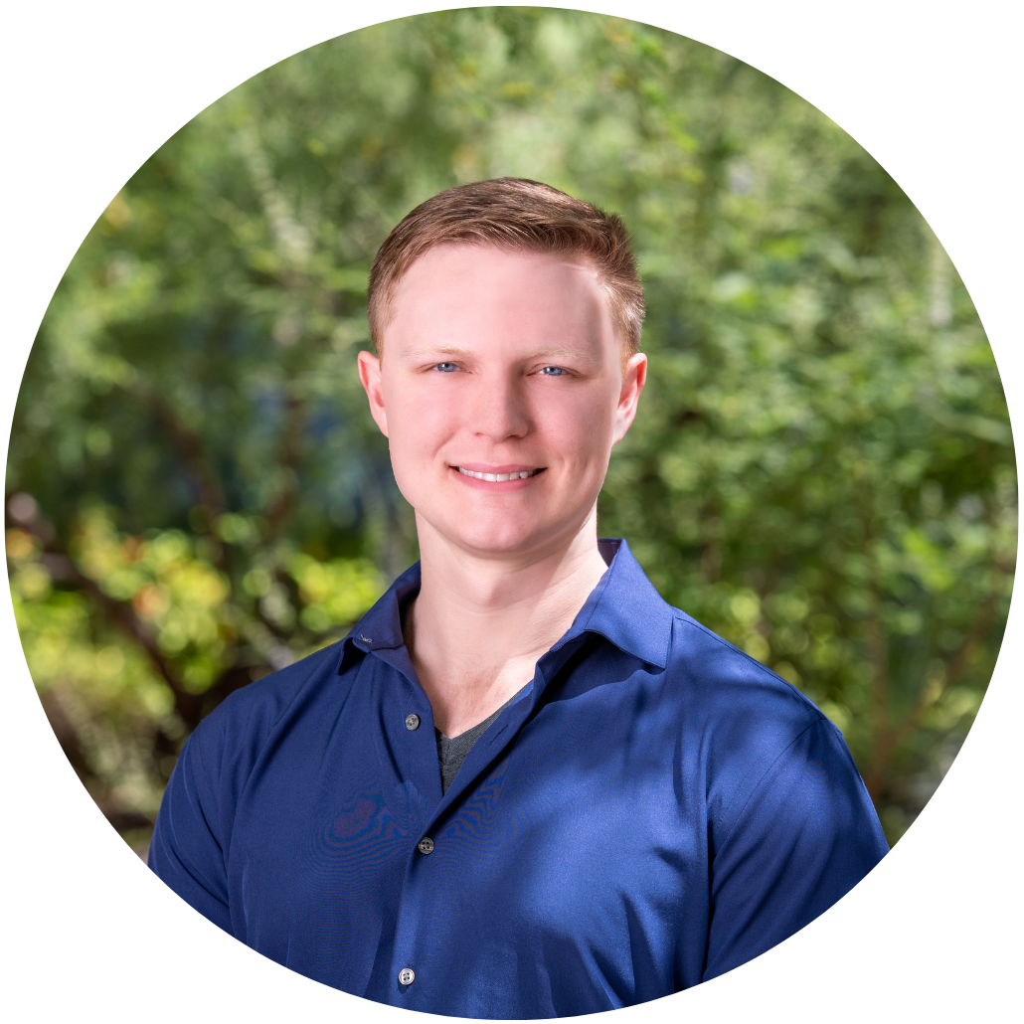
Meet the prof
Dr. Greg Chism
Assistant Professor of the Practice
Harvill 420

Slide 4
Meet each other!
Important
Introduce yourself via the #general channel in the course Slack

Slide 5
Meet data science
Data science is an exciting discipline that allows you to turn raw data into understanding, insight, and knowledge.
We’re going to learn to do this in a formulaic way – more on that later!
This is a course on introduction to data science, with an emphasis on statistical thinking and mathematics.

Slide 6
Software

Slide 7
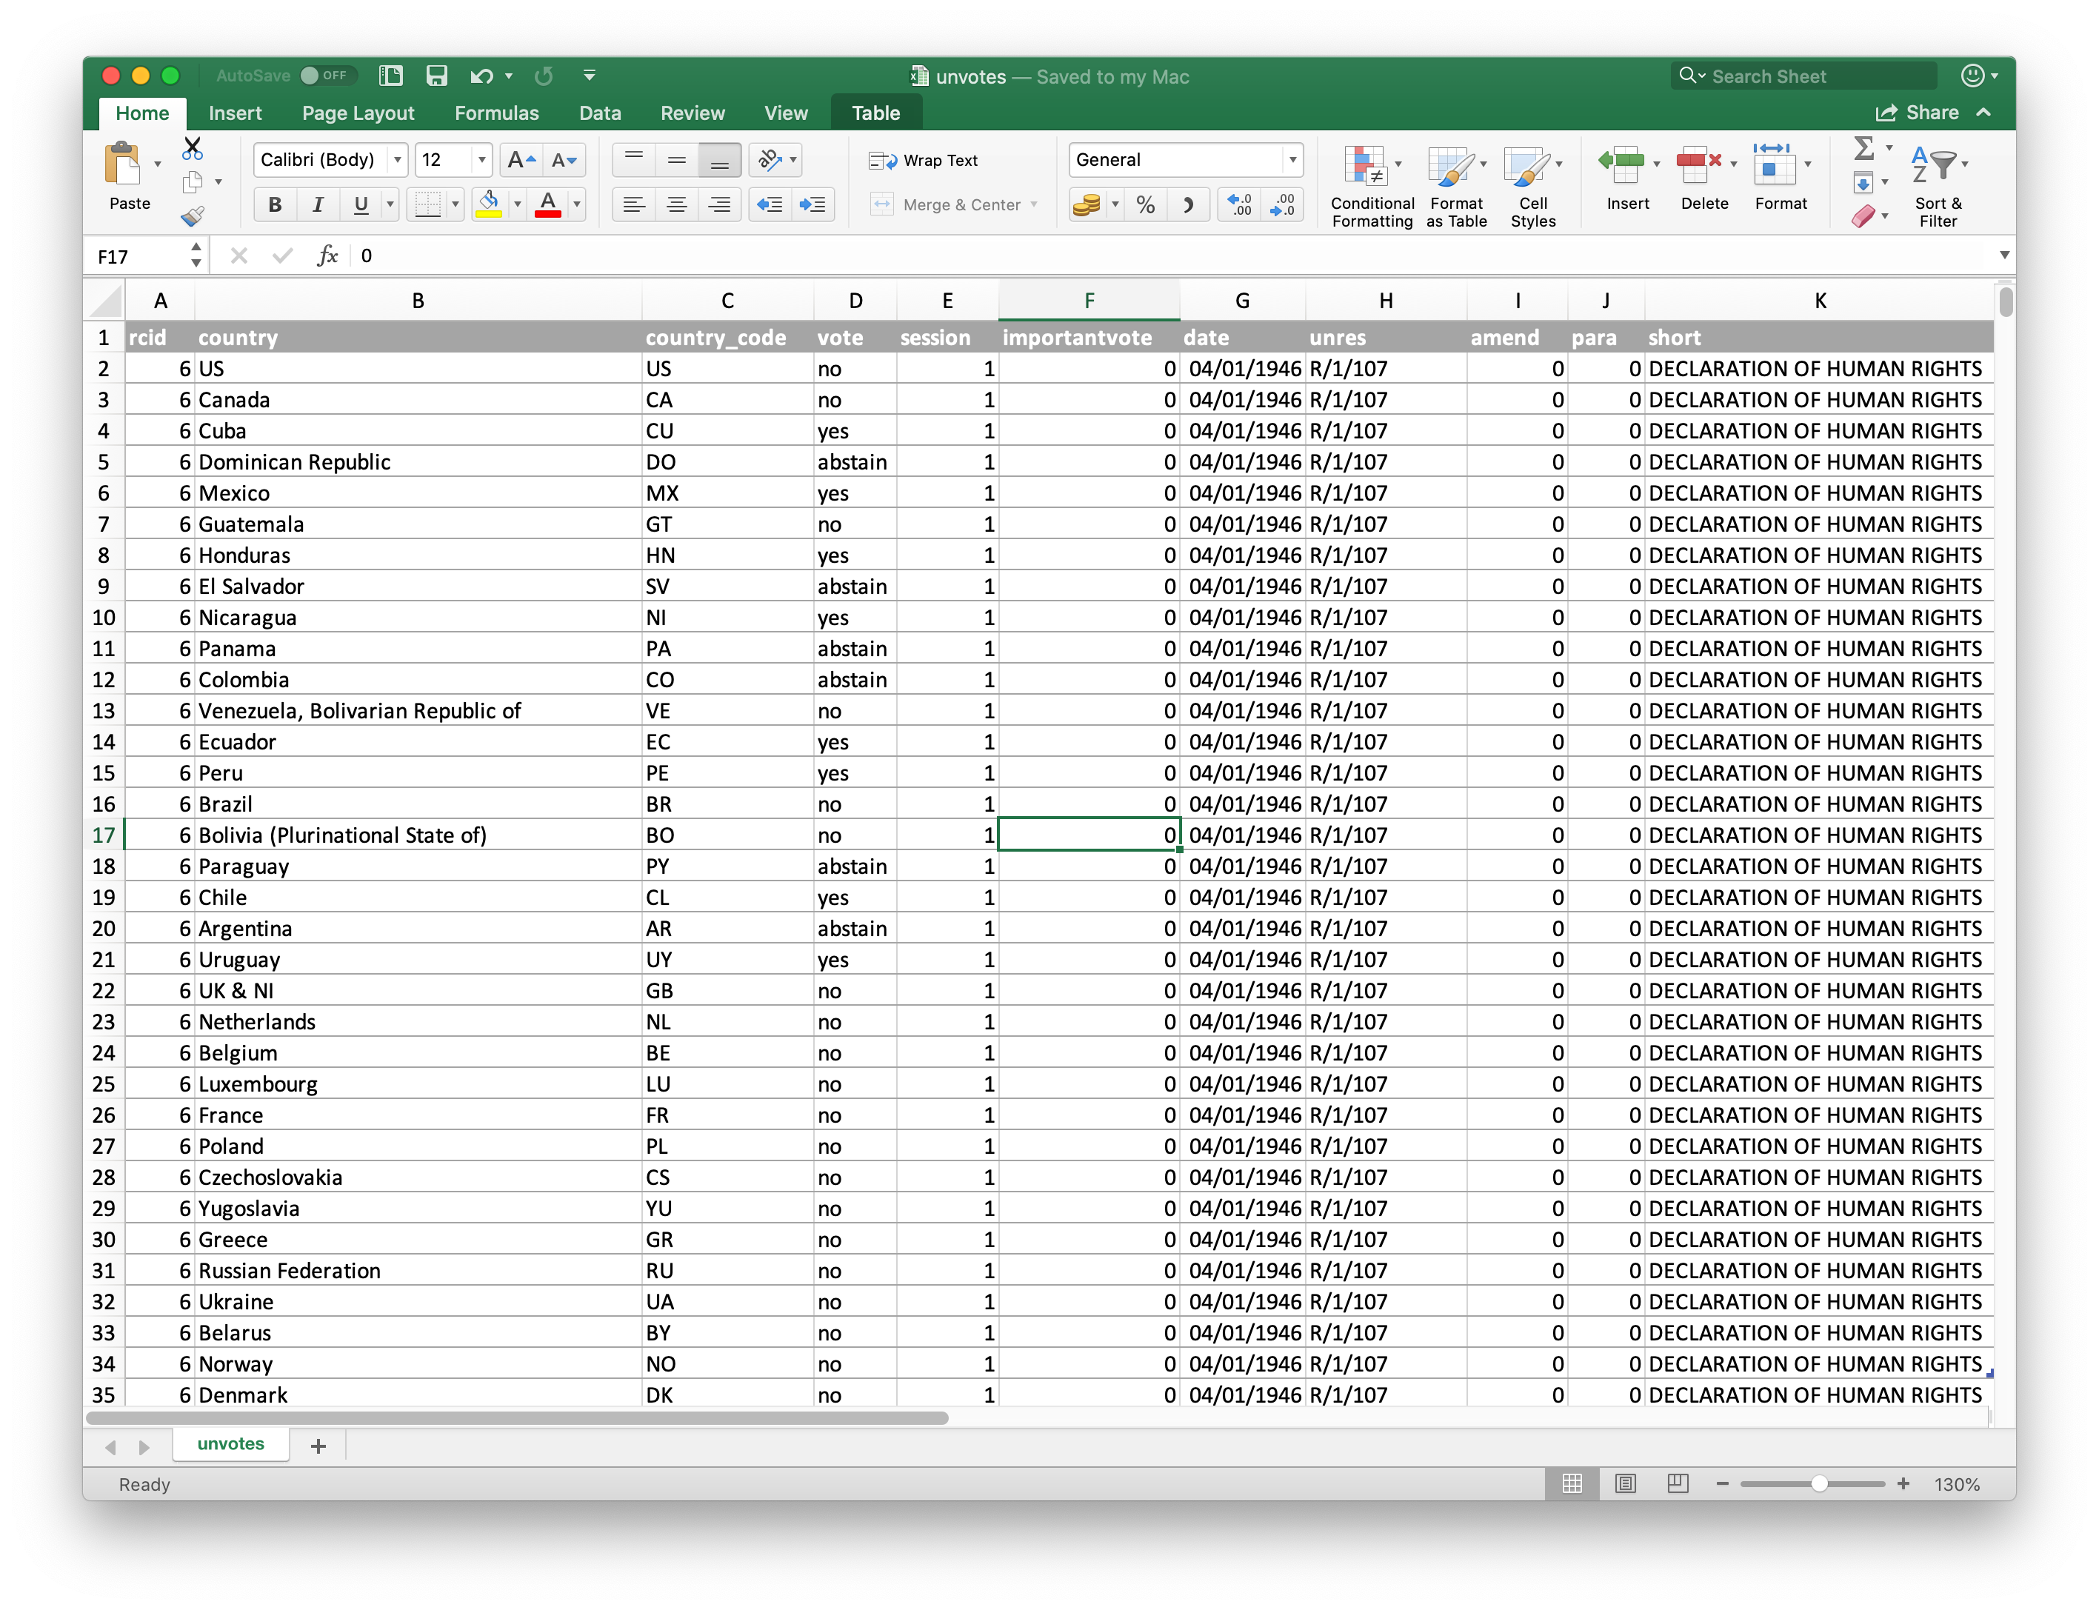
Excel - not…

Slide 8
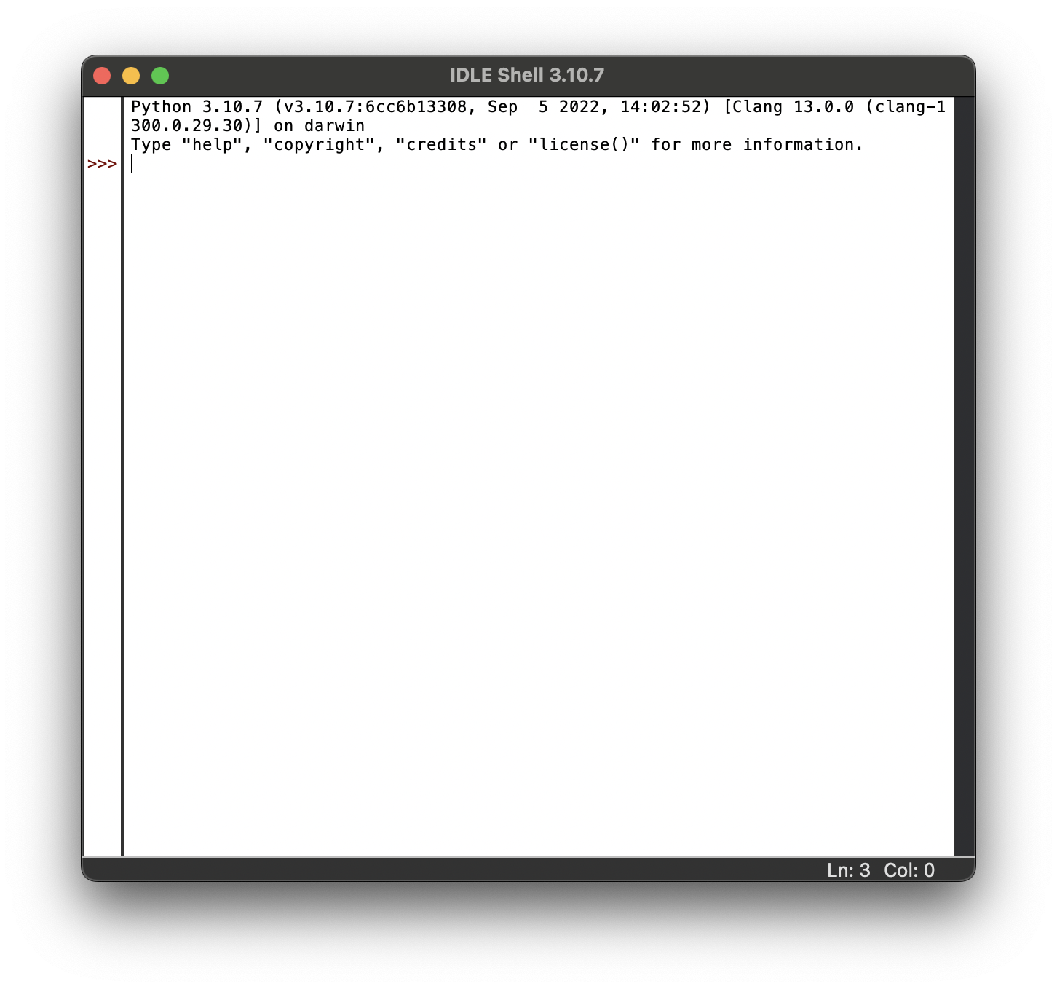
Python

Slide 9
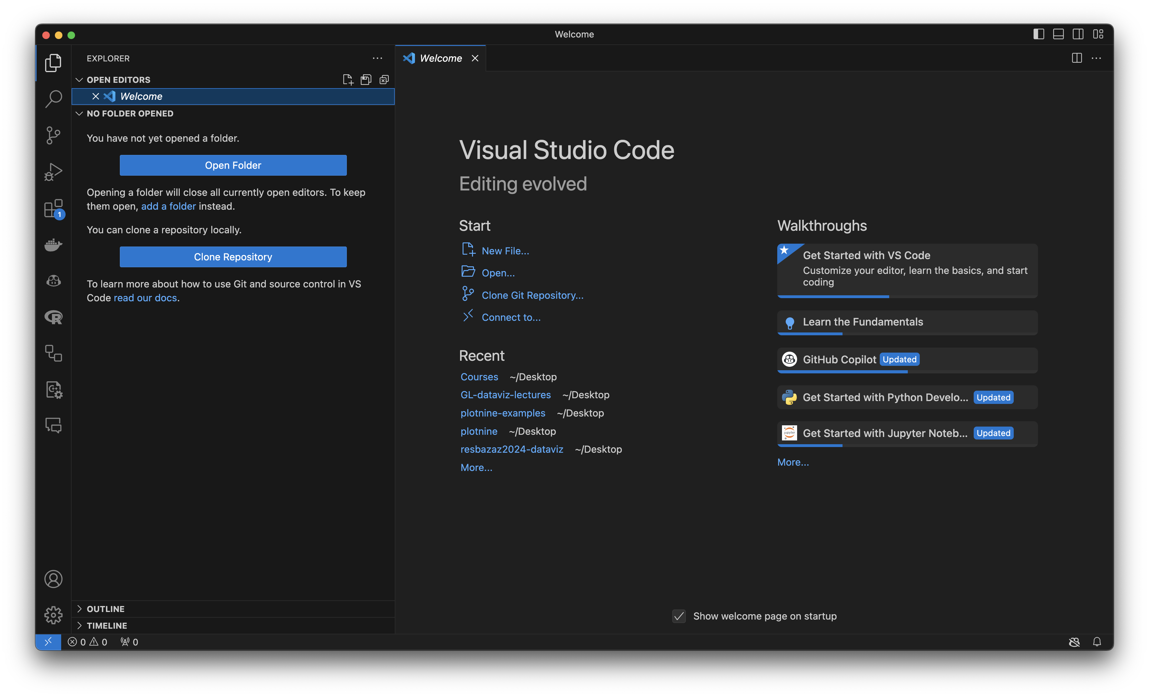
VS Code

Slide 10
Data science life cycle

Slide 11
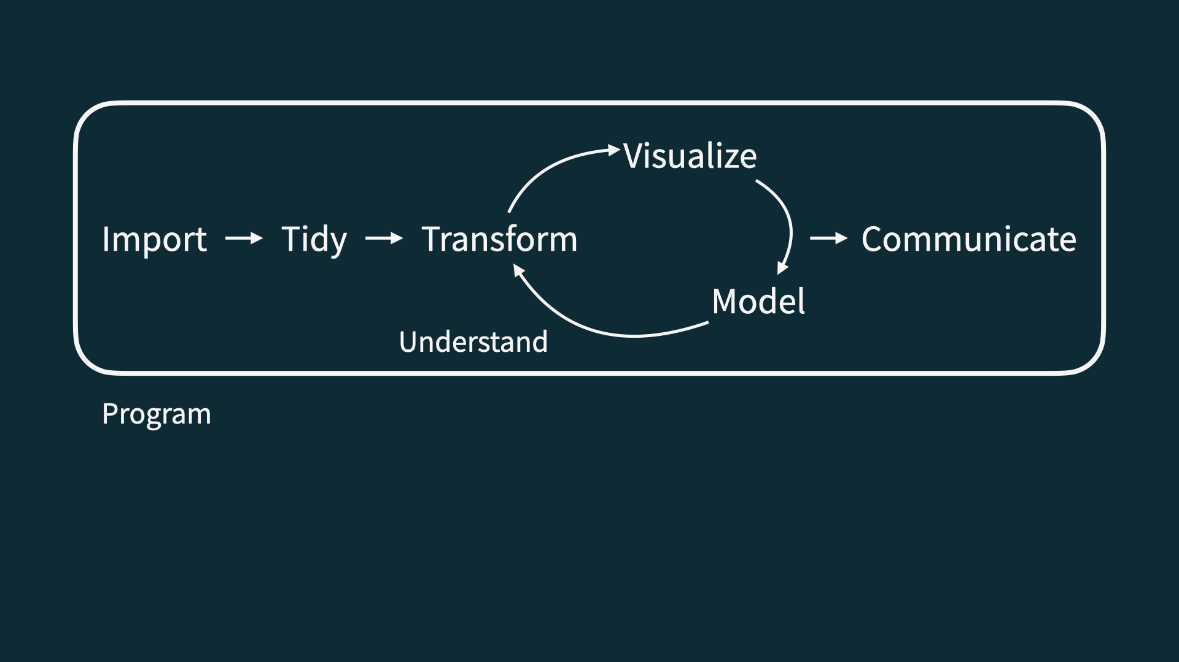
Data science life cycle

Slide 12
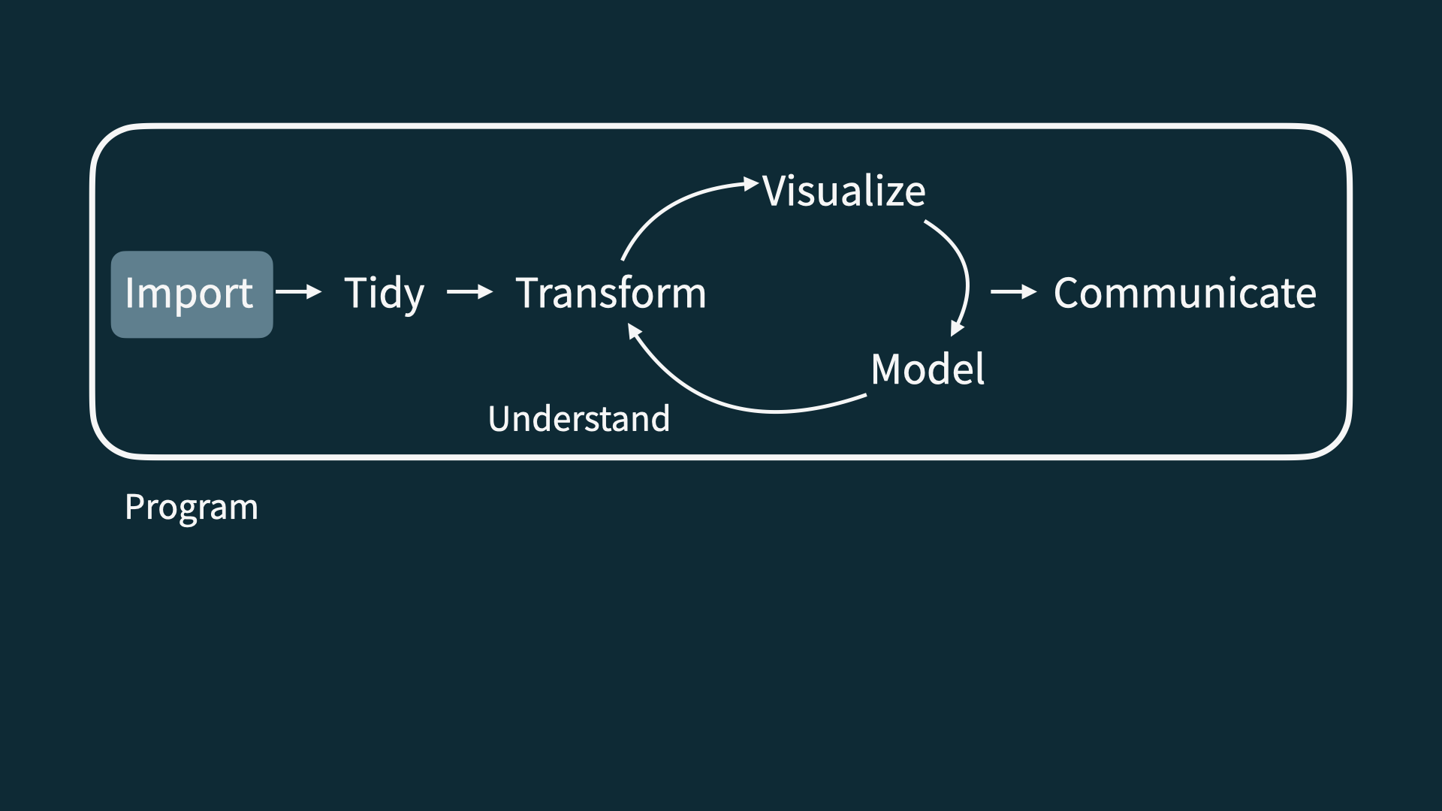
Import

Slide 13
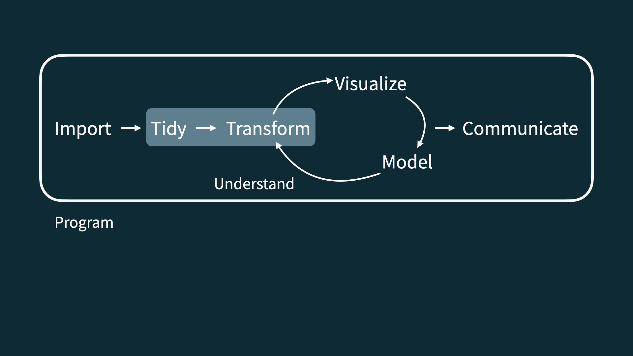
Tidy + transform

Slide 14
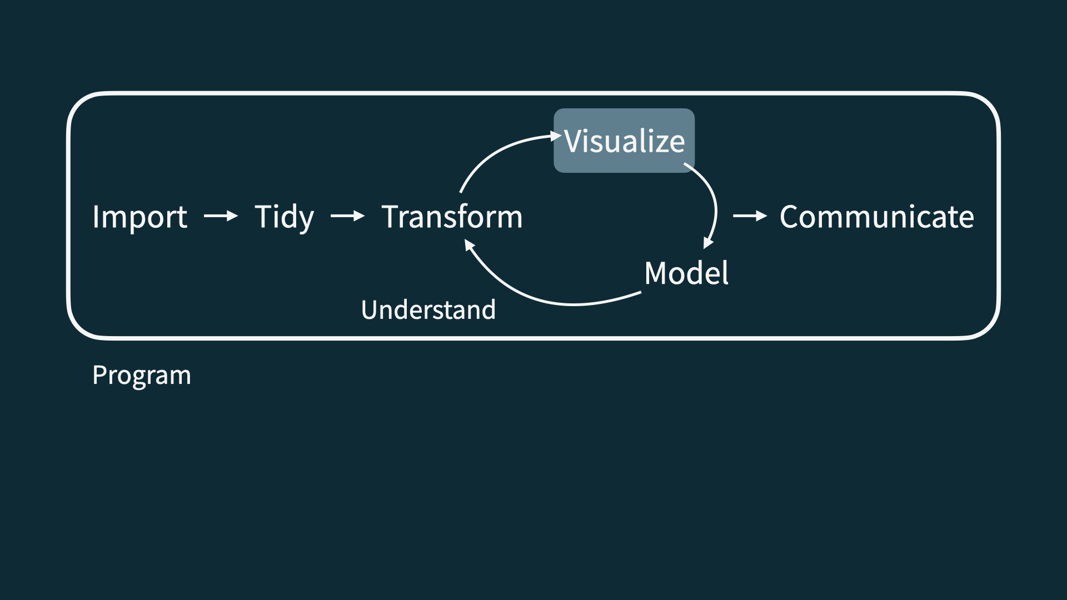
Visualize

Slide 15
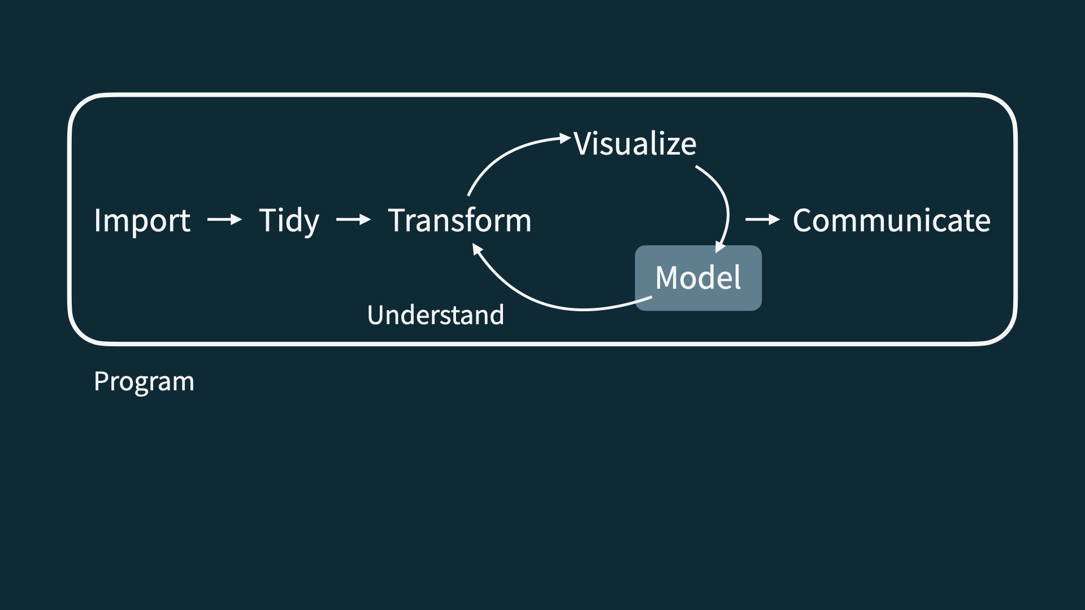
Model

Slide 16
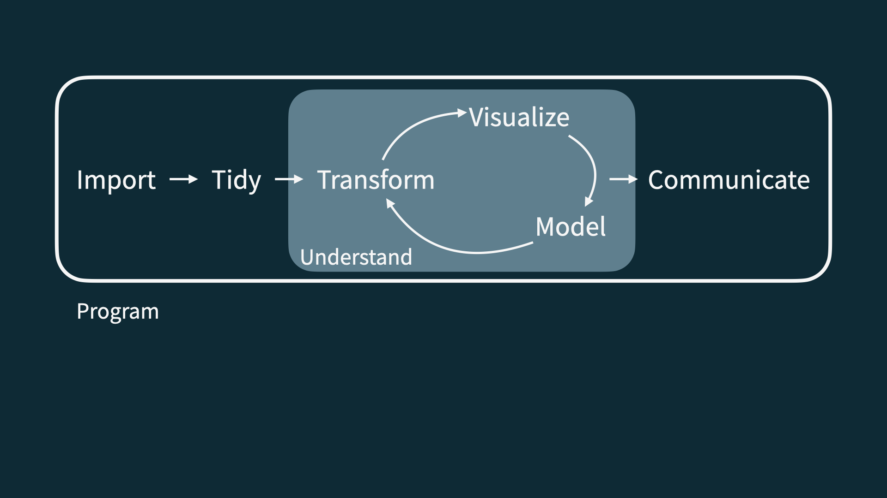
Understand

Slide 17
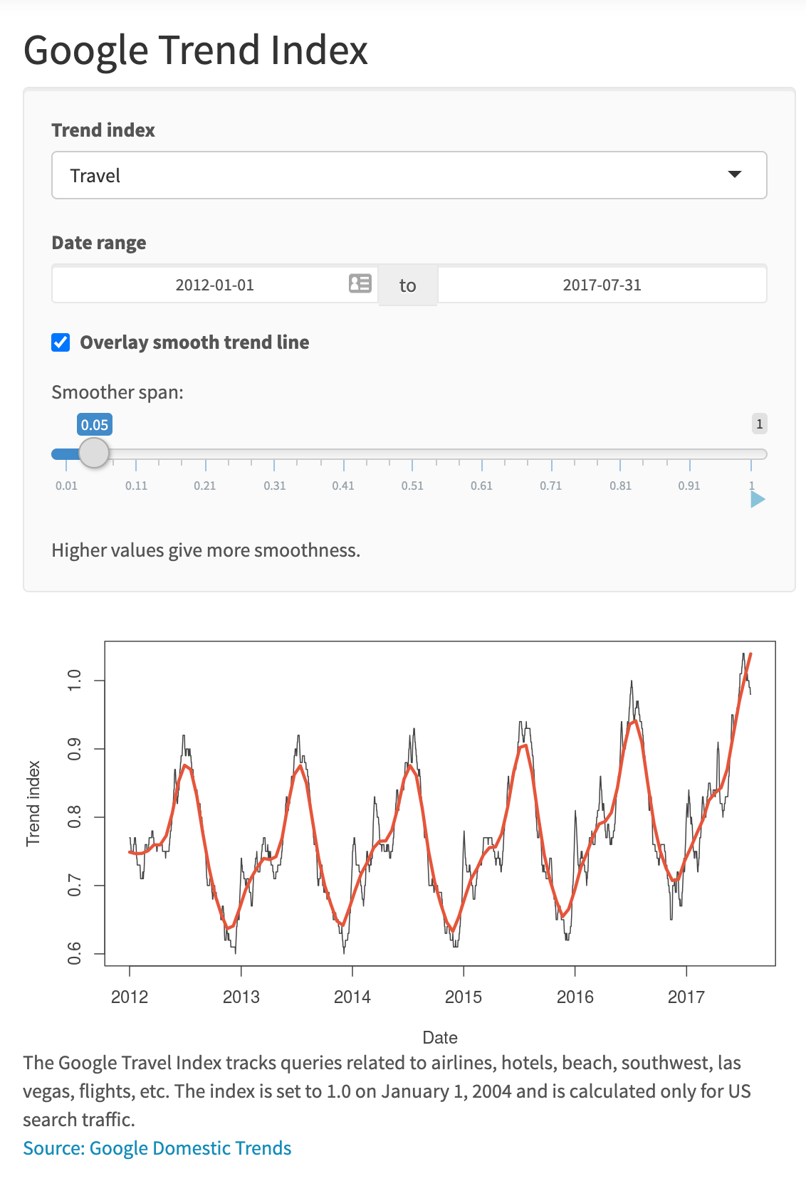

Slide 18
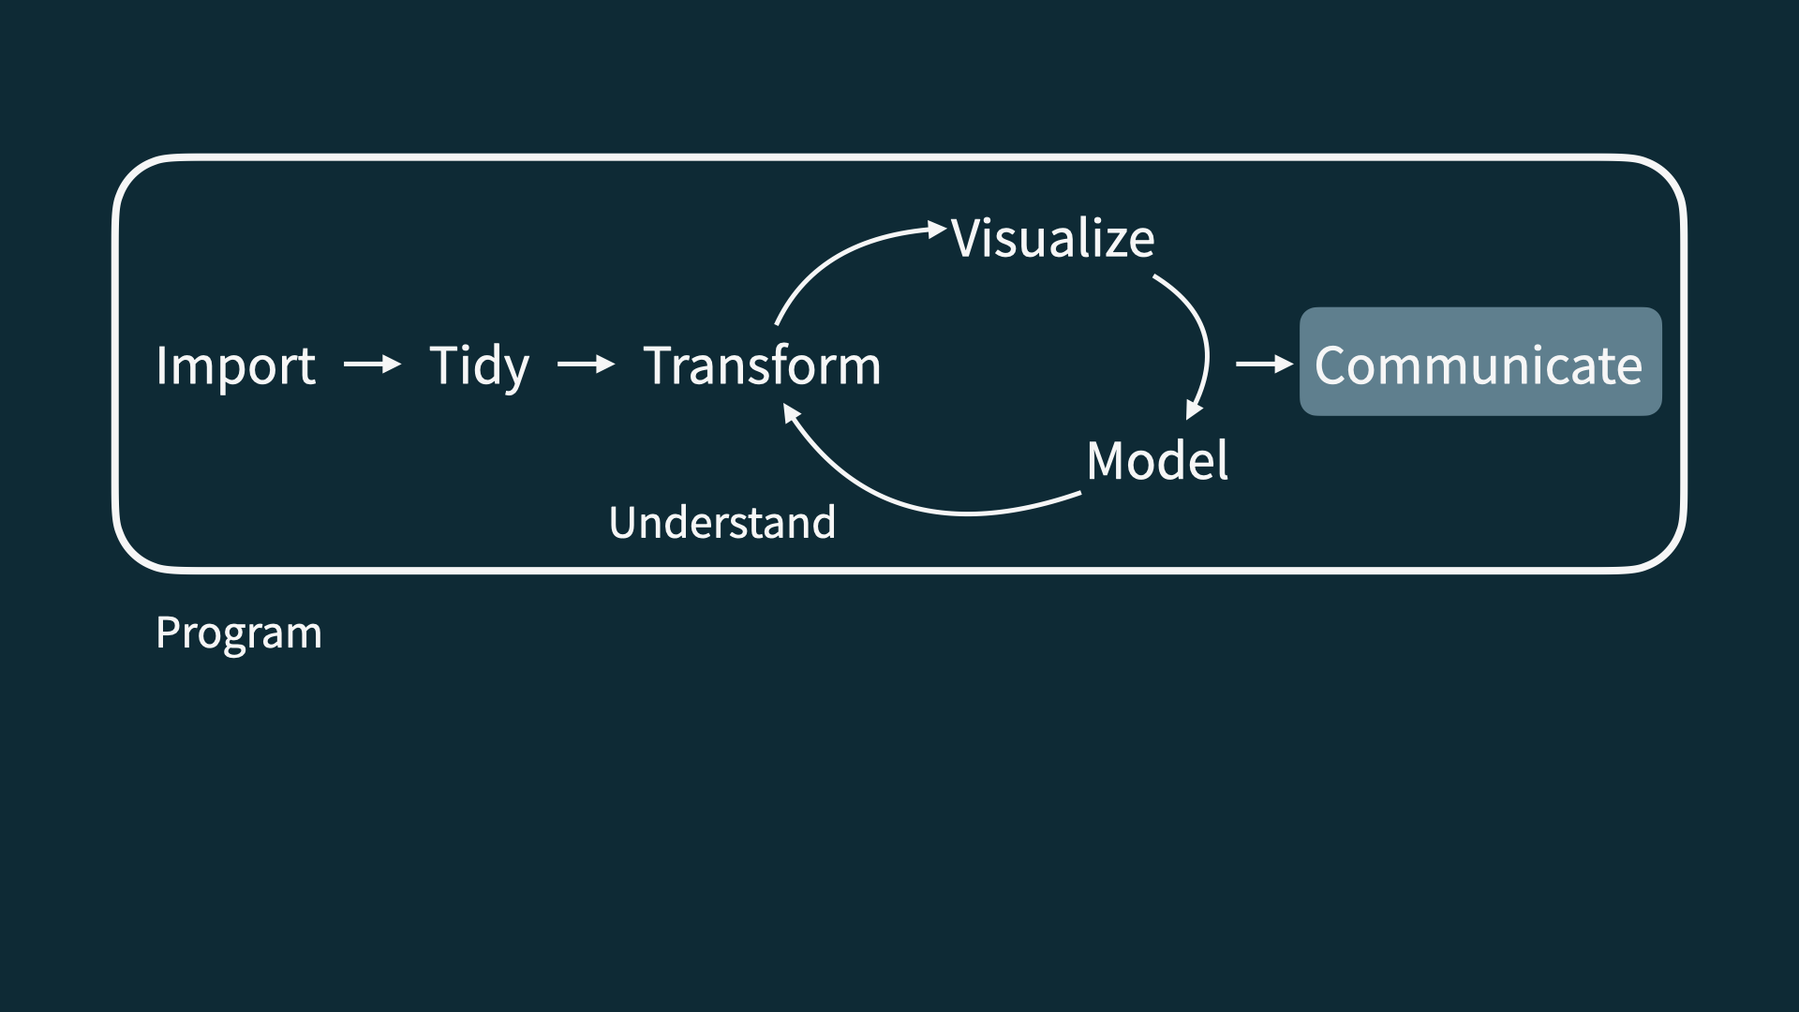
Communicate

Slide 19
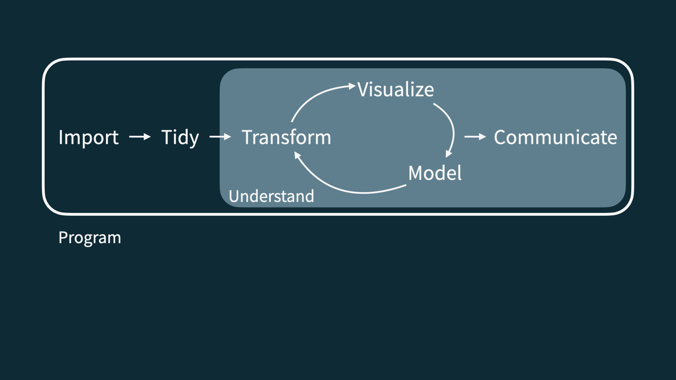
Understand + communicate

Slide 20
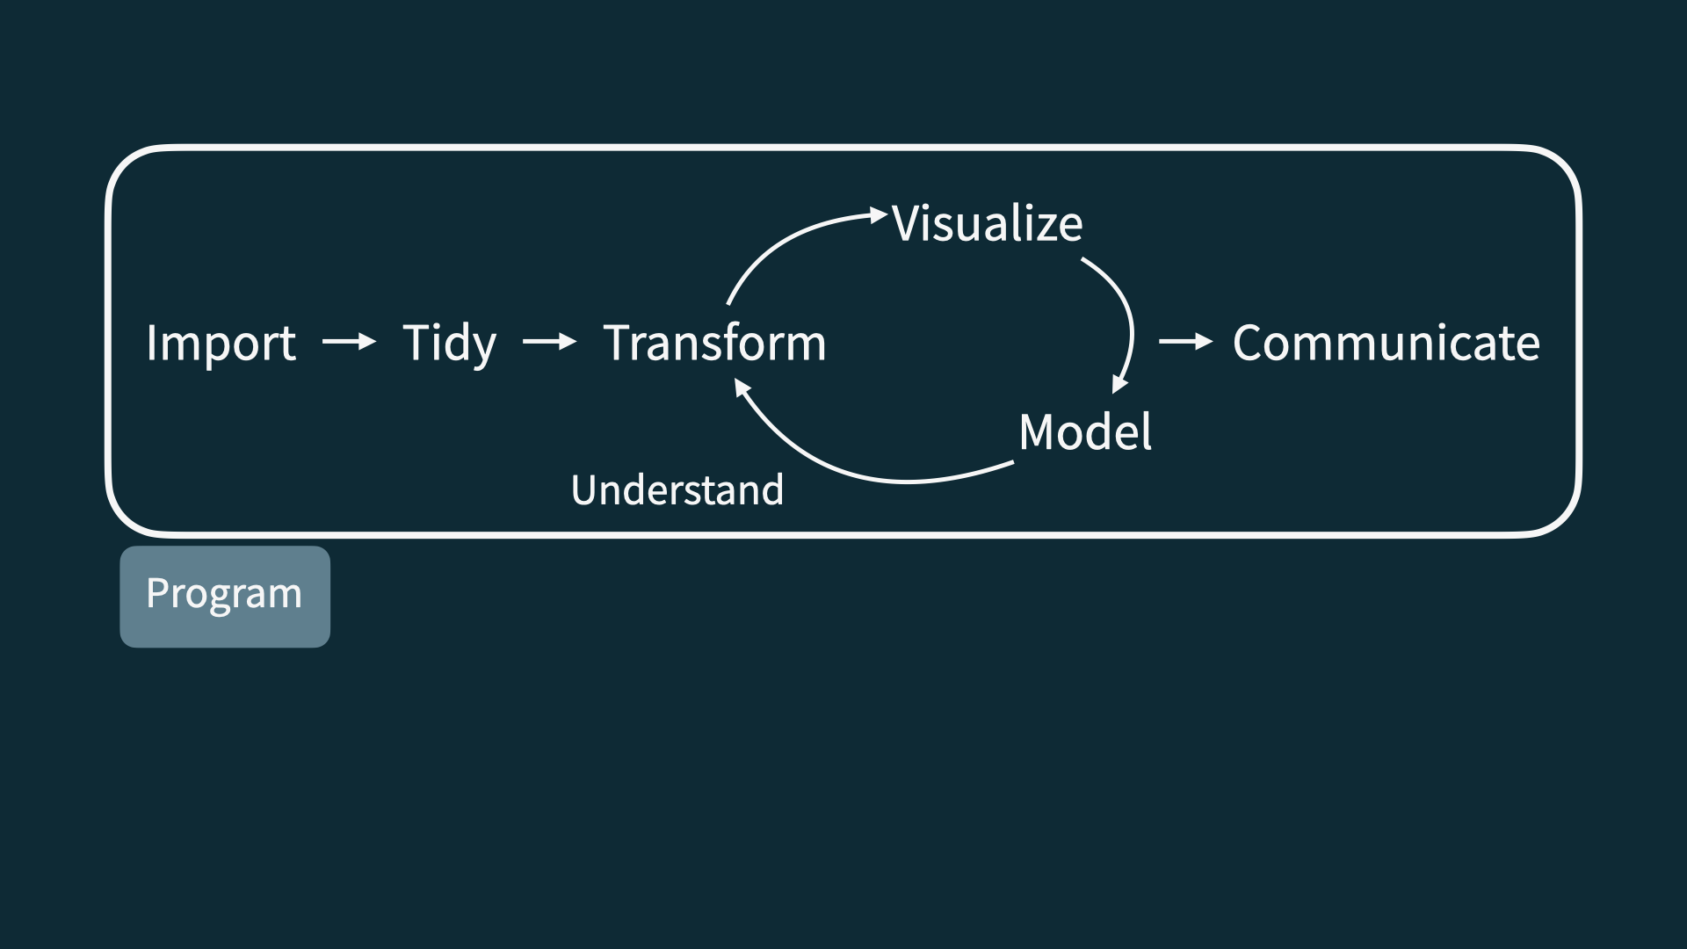
Program

Slide 21
Let’s dive in!

Slide 22
Application exercise
Or more like demo for today…
📋 github.com/INFO-511-F24/ae-00-unvotes

Slide 23
Course overview

Slide 24
Homepage
https://datasciaz.netlify.app/
All course materials
Links to GitHub, D2L, Posit Cloud (can run Jupyter), etc.

Slide 25
Course toolkit
All linked from the course website:
GitHub org: github.com/INFO-511-F24
Posit Cloud: posit.cloud
Communication: Slack
Assignment submission and feedback: Github

Slide 26
Activities
Introduce new content and prepare for lectures by watching the videos and completing the readings
Actively participate office hours, team meetings
Practice applying statistical concepts and computing with application exercises during lecture, graded for completion
Put together what you’ve learned to analyze real-world data
Lab assignments x 7
Exams x 2
Term project presented in the last lab session

Slide 27
Exams
Two exams, each 20%
Each exam comprised of two parts:
Take home: Focus on the analysis of a dataset introduced in the take home exam, or solve mathematical prompts
Caution
Exam dates cannot be changed and no make-up exams will be given. If you can’t take the exams on these dates, you should drop this class.

Slide 28
Project
Dataset of your choice, method of your choice
Teamwork
Presentation and write-up
Presentations in the last week (video recordings)
Interim deadlines, peer review on content, peer evaluation for team contribution
Caution
Final presentation date cannot be changed. If you can’t present on that date, you should drop this class. You must complete the project to pass this class.

Slide 29
Teams
Assigned by me
Project
Peer evaluation during teamwork and after completion
Expectations and roles
Everyone is expected to contribute equal effort
Everyone is expected to understand all code turned in
Individual contribution evaluated by peer evaluation, commits, etc.

Slide 30
Grading
Category | Percentage
Labs | 35%
Project | 20%
Exam 1 | 20%
Exam 2 | 20%
Application Exercises | 5%

Slide 31
No specific points allocated to participation, but participation via Slack, particularly Discussions, will be recorded periodically throughout the semester, and this information will be used as “extra credit” if you’re in between two grades and a minor bump would help.
See course syllabus for how the final letter grade will be determined.

Slide 32
Support
Attend office hours (by appointment)
Ask and answer questions on the discussion forum
Reserve email for questions on personal matters and/or grades
Read the course support page

Slide 33
Announcements
Posted on D2L (Announcements tool) but primarily sent via Slack, be sure to check both regularly
I’ll assume that you’ve read an announcement by the next “business” day

Slide 34
Diversity + inclusion
My goal is to ensure that students from all diverse backgrounds are well-served by this course, addressing their learning needs in and out of class, and recognizing the diversity they bring as a valuable resource and strength.
Please let me know your preferred name and pronouns on the Getting to know you survey.
If you feel like your performance in the class is being impacted by your experiences outside of class, please don’t hesitate to come and talk with me. I want to be a resource for you. If you prefer to speak with someone outside of the course, your advisers, and deans are excellent resources.
I (like many people) am still in the process of learning about diverse perspectives and identities. If something was said in class (by anyone) that made you feel uncomfortable, please talk to me.

Slide 35
Accessibility
The Disability Resource Center is available to ensure that students are able to engage with their courses and related assignments.
I am committed to making all course materials accessible and I’m always learning how to do this better. If any course component is not accessible to you in any way, please don’t hesitate to let me know.

Slide 36
Course policies

Slide 37
Late work, waivers, regrades policy
We have policies!
Read about them on the course syllabus and refer back to them when you need it

Slide 38
Academic integrity
To uphold the UArizona iSchool Community Standard:
I will not lie, cheat, or steal in my academic endeavors;
I will conduct myself honorably in all my endeavors; and
I will act if the Standard is compromised.

Slide 39
Wrap up

Slide 40
This week’s tasks
Complete Lab 0
Computational setup
Getting to know you survey
Read the syllabus
Start readings for next week

